Slide 1
COVID-19 Operational & Delivery Plan:
COMMUNITY HUBS

Slide 2
VENUES & OPERATING HOURS
VENUE | MONDAY to FRIDAY | SAT & SUN
Broadwood Stadium | 09:00 – 17:00 | closed
Airdrie Sports Centre | 09:00 – 17:00 | 10:00 – 15:00
Sir Mat Busby | 09:00 – 17:00 | closed
Ravenscraig Sports Facility | 09:00 – 17:00 | closed
Wishaw Sports Facility | 09:00 – 17:00 | closed
Shotts Sports Centre | 09:00 – 17:00 | closed
Ian Nicholson Centre | 09:00 – 17:00 | closed
St Andrews | 09:00 – 17:00 | closed
Garrowvale | 09:00 – 17:00 | closed

Slide 3
ACTIVITY AREA
Sports Halls (Small, Medium & Large)
Studios (Medium & Large)
Outdoor Activity Areas: Sports Pitches, Athletics Tracks, Grass Spaces
Classroom (Small studios, Meeting Rooms, Squash courts) (Require Tables & Chairs)

Slide 4
RESTRICTED ACCESS
Toilets (one person at any one time)
Staff Rooms / Welfare facilities (one person at any one time) (no shared utensils, food or crockery)
Offices (social distancing applies at all times)
Equipment store (two members of staff observing social distancing and manual handling)
Lifts (one person at any one time)
Break out areas (protective ‘Bubbles’)

Slide 5
CLOSED AREAS
Changing Facilities
Gyms
Spin Studios
Cafe & Vending
Drinking Fountains
All Wet Side facilities
Soft Play
Public Waiting Areas
Spectating Facilities
Self Service Kiosks
Turn styles
Ride on / Gamming Machines
Cash Tills
Resealable items
Fitness Matts

Slide 6
STAFFING LEVELS
NL Leisure
CNL & NLC
1 x Duty Manager
1 x Supervisor
1 x Reception
1 x Cleaner
2 x Leisure Attendant
4 x Coaches
2 x Culture
2 x CL&D
2 x Active Schools
2 x Volunteers

Slide 7
PRE-OPENING: BUILDING CHECKS
Venue Operations and Maintenance Team
Water hygiene and legionella treatment and checks
Heating and air-conditioning
Gas appliances
Electrical and deletion PAT testing
Emergency systems light fire & security
ITC equipment
Service contracts (Biffa, PHS, G4S)

Slide 8
PRE-OPENING: DEEP CLEANING
Venue Operations
Sanitise all key touch points
Ensure adequate cleaning and disinfecting stock levels
Remove all unnecessary ‘clutter’ (clear surface areas)
Remove all leaflet and leaflet holders
Increase litter bins – with lids
Toilets
Tables & Chairs and other equipment

Slide 9
PRE-OPENING: CUSTOMER JOURNEY
Venue Operations
Plan one-way layouts
Create external queueing systems
Install floor & wall signage
Locate hand sanitising stations
Locked up & secure closed areas
Remove/rearrange public seating areas to be socially distant. Create protective ‘bubbles’ breakout areas

Slide 10
PRE-OPENING: SIGNAGE SAMPLES
Venue Operations

Slide 11
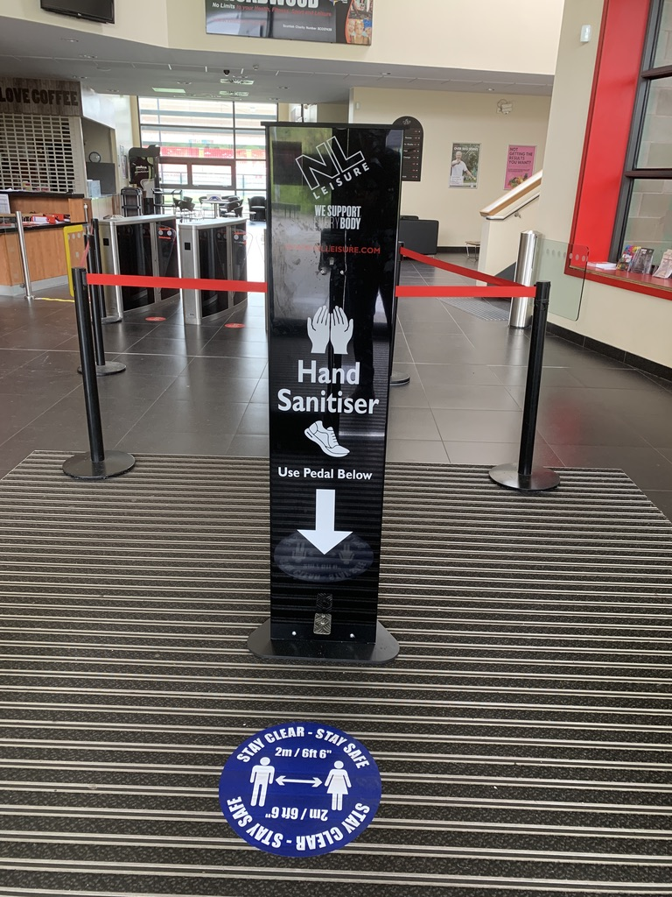
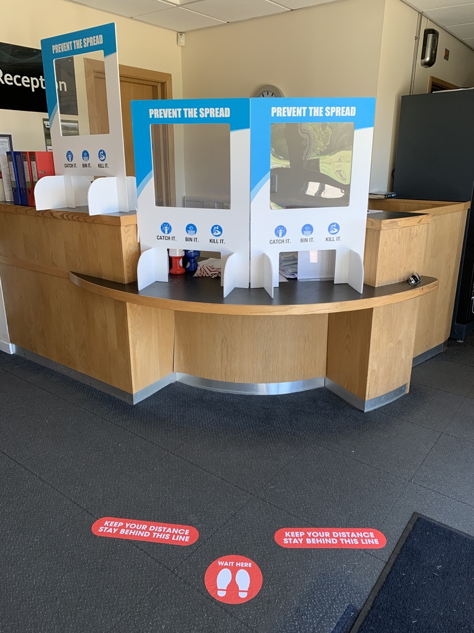
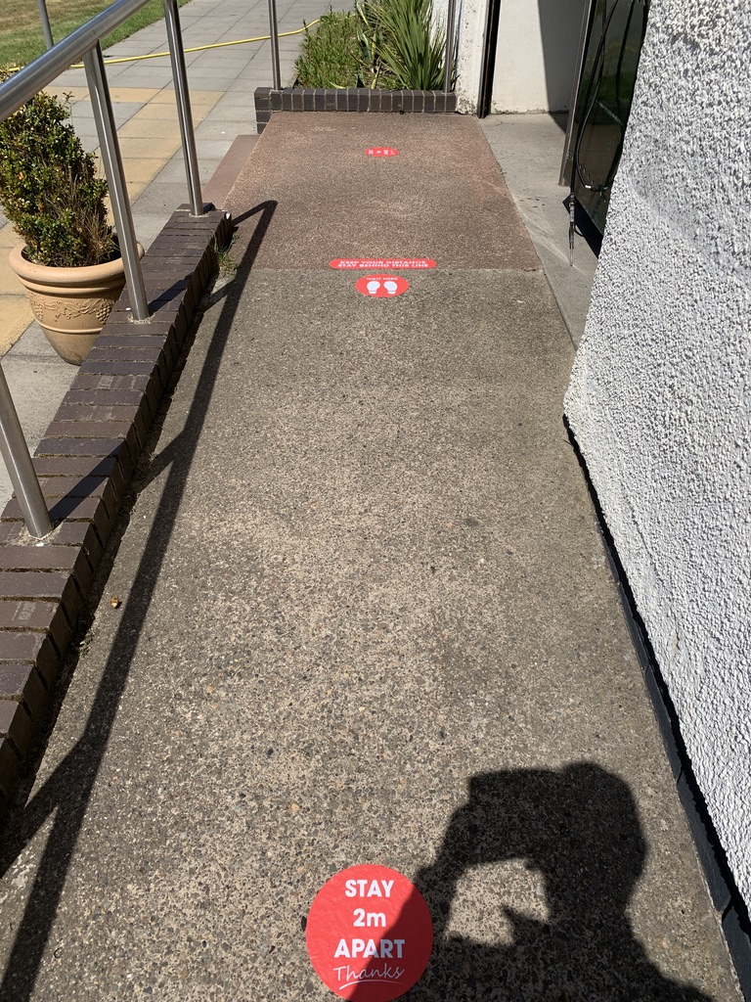
PRE-OPENING: SIGNAGE SAMPLES
Venue Operations

Slide 12
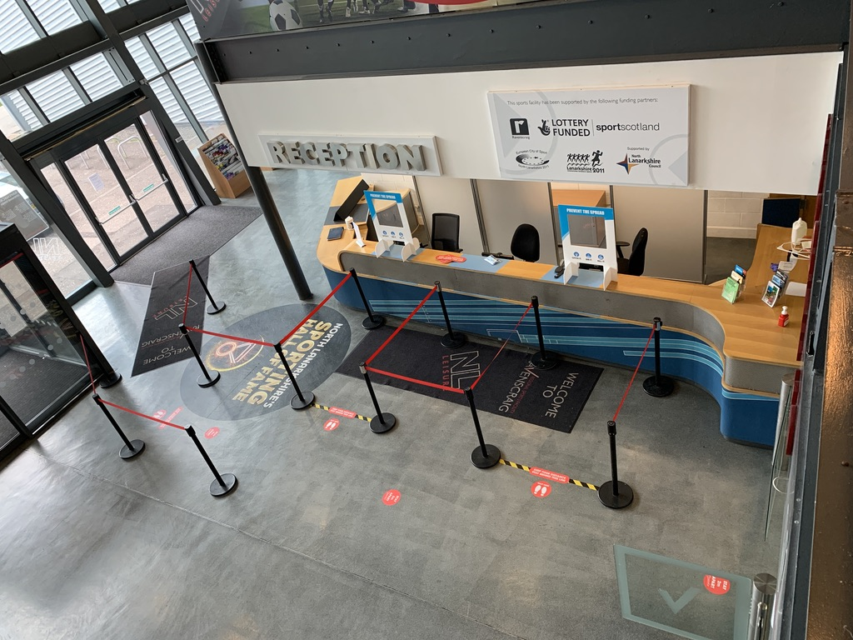
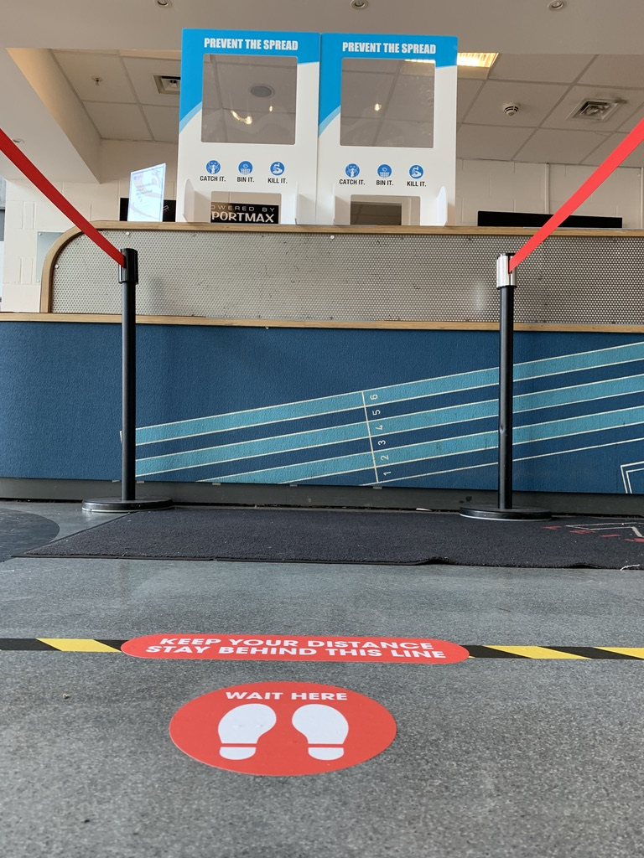
PRE-OPENING: SIGNAGE SAMPLES
Venue Operations

Slide 13
PRE-OPENING: HEALTH & SAFTEY
Venue Operations
Adapt venues in NOP’s/EAPs
Prepare staff individual PPE packs (Face masks, gloves & Personal Hand Sanitisers (100ml)
Install FOH Perspex Shield Guards (For one POS only)
Remove any additional front of house/office chairs
De-clutter (Reception areas, offices, staff rooms)
Remove all shared cutlery crockery from staff areas
Facilitate the delivery of COVID-19 staff training
Share staff rotas/shift patterns

Slide 14
ACTIVITY DELIVERY
Sports development Team
Be familiar with the venues in or NOP’s/EAPs (Carry out fire evacuation drill)
Develop a detailed program activity plan/timetable
Activity/lesson plans should be devised to deliver in an outdoor environment
Ensure all users adhere to and understand the social distance customer journey
Identify required sports equipment, ie;
Street soccer portable football pitch
Smoothie Bike
Balanceability bikes/helmets
Ensure robust equipment disinfectant regimes
Be aware of any socially distancing congestion points
Manage/stagger lunch and toilet breaks

